Slide 1
Glen Williams Community Association Presentation (supported by the Concerned Citizens of the Glen) Application by Eden Oak – 159 Confederation St., Glen Williams Prepared for: Mayor A. Lawlor and Town of Halton Hills Council
Presented by the Glen Williams Community Association, Development Committee
March 24, 2025
Glen Williams
Our Hamlet Our Home
Notes:
Good evening, Madam Mayor and Councillors,
My name is Joan Griffin and I am the president of the Glen Williams Community Association
We are here this evening to express our strong opposition to the application for development as submitted on December 6, 2024 to the Town of Halton Hills by Eden Oak, the owner of 159 Confederation St. requesting Official Plan Amendment, Zoning By-law Amendment and Draft Plan of Subdivision to allow for 81 townhouse dwelling units and 1 single detached dwelling on a new private road.
We have many concerns with the reports as filed however this evening I will speak to our primary concerns.
We will submit to Town staff our full issues list after this meeting.

Slide 2
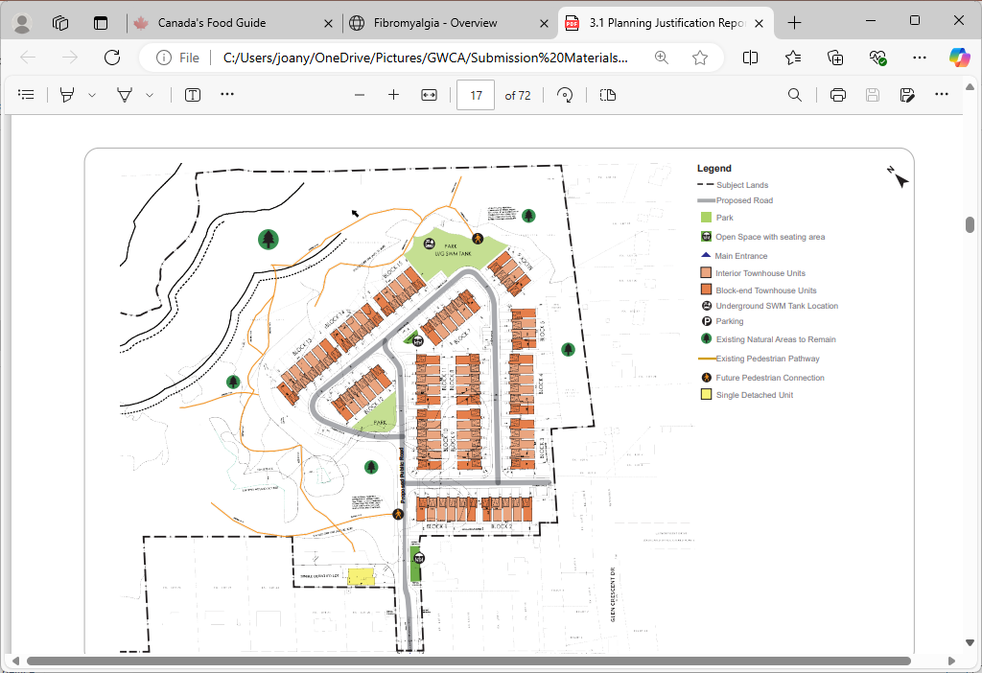
Proposed Site Design
Confederation St
Notes:
Here you can see a visual of the proposed site design

Slide 3
The Glen Williams Community Association (GWCA)
Recognized voice of the hamlet since 1999, incorporating as a non-profit residents’ association in 2016.
Elected Board of Directors, representing approx. 500 members.
Publicly posted annual action plans.
Extensive reach in the community:
community events, public meetings, Annual AGM
well-used and informative website about Glen Williams and the GWCA
regular electronic newsletter with upwards of 900 subscribers
Facebook/Instagram following upwards of 950
Notes:
While we do work closely with our Ward 2 Councillors and Regional Councillor Somerville, we have not had an opportunity to work with many of you, so, by way of a brief introduction
The GWCA has been the recognized voice of the hamlet since 1999, incorporating as a non-profit association in 2016
We currently have approximately 500 members. Members must live within the official hamlet boundaries as established by the Town or own a business in the hamlet.
The Board of Directors is made up of GWCA members who volunteer their time and efforts to help protect the hamlet’s natural features and to keep the Glen a great place to live.
The board is committed to
Listening to what matters most to Glen residents.
Representing members and honoring the GWCA mission in all our actions and decisions.
Representing the hamlet’s interests to local government, participating on policy committees, developing grassroots campaigns.
Being stewards of the Glen Williams Secondary Plan, helping to ensure that any proposed changes to the hamlet align with the requirements of the Plan; with the goals being to protect and preserve the natural and cultural heritage features of the Hamlet.
And to executing the GWCA annual plans including activities focused on building a shared sense of community and enriching the quality of life in the hamlet.
Annual action plans are drafted by the Board, reviewed with membership and publicly posted.
The GWCA has an extensive reach within the community through community events, public meetings, an annual AGM, a well used and informative website, monthly newsletters to over 900 subscribers and social media platforms with upwards of 900 followers.

Slide 4
The Glen Williams Secondary Plan
The application as filed is in direct violation of the recently approved provisions of the Glen Williams Secondary Plan
GWCA & Glen residents participated in creation of initial plan; formally approved 2007.
Update to plan initiated by Town in 2019.
Official Plan Amendment #44 approved by Council June 2021, approved by Region July 2022.
Appeal filed Oct. 2022 with Ontario Land Tribunal (OLT) by three developers (each had an active development proposal in the Glen, two also had their own appeals at the OLT).
GWCA received party status in this Tribunal proceeding.
Tribunal file closed, Dec. 2024. Resulting in no changes to the previously approved OPA #44.
Notes:
The application as filed is in direct violation of the recently approved provisions of the Glen Williams Secondary Plan
Some background about the Glen Williams Secondary Plan OPA 44, that is relevant to highlight.
Board members and many Glen residents participated in the creation of the initial version of the plan approved by the Region in 2007 after all appeals were resolved.
An update review was then initiated by the Town in 2019.
The scoped review included a number of technical studies and engagement with the GWCA and the community.
The purpose of that amendment was to implement updated policy directions that had been developed by the Town of Halton Hills, through a scoped review of the existing plan.
Official Plan Amendment #44 was presented to Town Council and approved in June, 2021. and then approved by the Region In July, 2022.
An Appeal was filed with the Ontario Land Tribunal in Oct., 2022 against the updated Plan by three developers that each had active development proposals in the Glen. Two of those developers, one being Eden Oak also had their own appeals at the Tribunal.
The GWCA was a Party in this tribunal proceeding.
The tribunal file was closed in Dec. 2024. No changes were made to the previously approved Secondary Plan as a result of this appeal by the developers.
Secondary Plan OPA 44 provides a detailed planning framework for the Hamlet of Glen Williams in support of the general policy framework provided by the Halton Hills Official Plan.
The GWCA is not opposed to development. We support appropriate development in terms of how the hamlet should grow as laid out in the recently approved Glen Williams Secondary Plan.

Slide 5
The Eden Oak Application
Secondary Plan’s Character Objectives
The proposal for 81 Townhouses spread over 15 blocks introduces an urban built form into a rural hamlet.
The Hamlet Residential Area designation achieves policy H4.5.1 by permitting “…gradual and limited growth over time in a manner that is consistent with the character of the Hamlet…”.
The Secondary Plan section H4.5.2 a) as approved explicitly rejects built forms that are not single detached residential uses.
You cannot amend one, without undermining the other.
Notes:
Over the next few slides, I will highlight some examples of where this application is in direct violation of the provisions as laid out in the Glen Williams Secondary Plan
Under the Secondary Plan’s Character Objectives
The proposal for 81 Townhouses spread over 15 blocks introduces an urban built form into a rural hamlet.
This policy achieves policy H4.5.1 by permitting “…gradual and limited growth over time in a manner that is consistent with the character of the Hamlet…”.
The Secondary Plan section H4.5.2 as approved, explicitly rejects built forms that are not single detached residential uses.
You cannot amend one, without undermining the other.

Slide 6
The Eden Oak Application
Secondary Plan’s Character Objectives – Cont’d
The proposal’s uniform lot frontages, setbacks, driveways and perceived lot sizes concentrates a single design repeated 81 times.
The Secondary plan recognizes the variety of lot configurations in the Hamlet as a part of its character, the uniform repetition of the lot fabric undermines policy section H4.5.1 that requires new development to provide “…a variety of lot sizes and setbacks…”.
Nowhere in the Hamlet can we find a repetitious urban design such as this, which indicates the proposal is not serving to “…preserve and build upon the unique heritage character of Glen Williams as a distinct hamlet…”, but rather upending this policy objective. Section H4.2(b)
Notes:
The proposal’s uniform lot frontages, setbacks, driveways and perceived lot sizes concentrates a single design repeated 81 times.
The Secondary plan recognizes the variety of lot configurations in the Hamlet as a part of its character, the uniform repetition of the lot fabric undermines policy section H4.5.1 that requires new development to provide “…a variety of lot sizes and setbacks…”.
Nowhere in the Hamlet can we find a repetitious urban design such as this, which indicates the proposal is not serving to “…preserve and build upon the unique heritage character of Glen Williams as a distinct hamlet…”, but rather upending this policy objective.

Slide 7
The Eden Oak Application
Application requests significant variances to zoning requirements
400% increase in units per hectare is being requested.
. | Min. Lot frontage | Min. lot area | Min. required front yard | Min. required rear yard | Min. required interior side yard | Min required exterior side yard | Max. height
Zoning requirement | 30.0m | 0.1ha | 4.5m | 7.5m | 2.25m | 4.5m | 11.0m
Proposed | 7.2m | 0.02ha | 4.5m | 4.2m | 1.5m | 1.5m | 11.5m
Variance | 76% reduction | 80% reduction | 0 | 44% reduction | 33% reduction | 66% reduction | 4.5% increase
Notes:
This application requests significant variances to zoning requirements.
The proposal requests substantial reductions to the space and setback requirements mandated by the Secondary Plan and Town rules as you can see outlined here in this chart.
A 400% increase in units per hectare is being requested.

Slide 8
The Eden Oak Application
Applicant’s justification for dense form of development
The applicant suggests that the Provincial Policy Statement 2024, Section 1.4.1 provides justification for the proposed dense form of development
1.4.1 To provide for an appropriate range and mix of housing options and densities required to meet projected requirements of current and future residents of the regional market area, planning authorities shall: b) maintain at all times where new development is to occur, land with servicing capacity sufficient to provide at least a three-year supply of residential units available through lands suitably zoned to facilitate residential intensification and redevelopment, and land in draft approved and registered plans.
The Town of Halton Hills does not require 81 Townhouses in a rural hamlet to meet this requirement. Sufficient new developments are already approved to meet the Town’s obligations.
Notes:
The applicant suggests that the Provincial Policy Statement 2024, Section 1.4.1 provides justification for the proposed dense form of development
Section 1.4.1 states
To provide for an appropriate range and mix of housing options and densities required to meet projected requirements of current and future residents of the regional market area, planning authorities shall: b) maintain at all times where new development is to occur, land with servicing capacity sufficient to provide at least a three-year supply of residential units available through lands suitably zoned to facilitate residential intensification and redevelopment, and land in draft approved and registered plans.
The Town of Halton Hills Planning staff have confirmed they do not require 81 Townhouses in this rural hamlet to meet this requirement.
Sufficient new developments are already approved to meet the Town’s obligations.

Slide 9
The Eden Oak Application
Applicant’s justification links to Provincial Policy Statement 2024 – Cont’d
“The proposed development will promote long-term economic prosperity by helping to enhance and diversify the Town of Halton Hills’ housing stock with options that appeal to different household sizes and incomes. The proposed development will respond to the lack of smaller homes attainable for smaller families, couples, and single occupants, which provides additional opportunities for residents to ‘age in place’ and makes the community more inclusive.” (PJR pg.42)
Proposed units will range from 2,190 to 2,400 square feet, likely 2-3 stories with stairs and ongoing Home Owner Association fees.
There already is a wide range of housing options in the Glen.
Notes:
Further to the argument of providing the Town of Halton Hills housing stock with options, the applicant states in the Planning Justification Report on pg. 42
that the proposed development will respond to the lack of smaller homes attainable for smaller families, couples, and single occupants, which provides additional opportunities for residents to ‘age in place’ and makes the community more inclusive.
These proposed units will range in size from 2,190 to 2,400 square feet. This square footage does not compute with the statement that this development would be responding to the lack of smaller homes. It is also highly doubtful that these units would qualify as “affordable” to purchase also given the ongoing Home Owner Association Fees due to the development being on a private road.
With a lot frontage of 7.5m and a proposed height exceeding the maximum allowable it appears the units are proposed to be 2-3 floors with many stairs. This does not equate to conducive “age in place” type of units.
There already is a wide range of housing options in the Glen. Many original small homes can be found in addition to the subdivisions.

Slide 10
The Eden Oak Application
Applicant’s justification links to Provincial Policy Statement 2024 – Cont’d
“The PPS 2024 supports intensification, infill, and redevelopment where appropriate in order to promote the efficient use of land where infrastructure and public services are available.”
The PPS 2024 designates settlement areas as the primary locations for growth and development, further defining Strategic Growth Areas: Within settlement areas, growth should be concentrated in strategic growth areas, including major transit station areas.
1.1.3.1 Settlement areas shall be the focus of growth and development.
1.1.3.2 Land use patterns within settlement areas shall be based on densities and a mix of land uses which:…. f) are transit-supportive, where transit is planned, exists or may be developed.
The Glen as a rural hamlet clearly does not fit these definitions.
Notes:
The applicant repeatedly leans on the Provincial Policy Statement 2024 to justify the proposed design.
However there are clear distinctions within the PPS that should guide its application. For example, the first bullet as taken from the PPS says
The PPS supports intensification, infill, and redevelopment where appropriate in order to promote the efficient use of land where infrastructure and public services are available.
The PPS 2024 designates settlement areas as the primary locations for growth and development, further defining Strategic Growth Areas: Within settlement areas, growth should be concentrated in strategic growth areas, including major transit station areas.
Section 1.1.3.1 Settlement areas shall be the focus of growth and development.
Section 1.1.3.2 Land use patterns within settlement areas shall be based on densities and a mix of land uses which:…. f) are transit-supportive, where transit is planned, exists or may be developed.
We have to question if the Glen as a rural hamlet realistically applies here?

Slide 11
The Eden Oak Application
Connectivity and Open Space
Proposal contemplates a condominium ownership structure on a private road.
Only intended conveyance to municipality is Block 4 Environmental Area.
If the proponent intends to keep blocks 1,2 and 5 private, the application undermines several Secondary Plan objectives and fails to conform to policies:
The site plan and draft plan suggest certain trails will terminate at what will become “the condo’s property line”, undermining the reinforcement “…of visual and physical access to open space…” and short stopping “…linkages to the commercial and community facilities of the hamlet core area”. (H4.2(d) and (e))
The site plan identifies a park like area and a play area, which, presumably, will be only accessible to members of the condominium units. The private provision of private parks which excludes “…the existing…community…” from enjoying the links between “…existing open spaces, natural features, and parks…”. (H4.2(k))
Notes:
With respect to connectivity and open space
The proposal contemplates a condominium ownership structure.
The only intended conveyance to the municipality is Block 4, the Environmental Area.
With respect to the environmental area, among other concerns, its not clear how the limits of the environmental area were achieved in the applicant's submissions.
If the proponent intends to keep blocks 1,2 and 5 private, then the application undermines several GWSP objectives and fails to conform to policies.
Specifically:
o The site plan and draft plan suggest certain trails will terminate at what will become “the condo’s property line”, undermining the reinforcement “…of visual and physical access to open space…” and short stopping “…linkages to the commercial and community facilities of the hamlet core area”. (H4.2(d) and (e))
And,
o The site plan identifies a park like area and a play area, which, presumably, will be only accessible to members of the condominium units. The private provision of private parks which excludes “…the existing…community…” from enjoying the links between “…existing open spaces, natural features, and parks…”. (H4.2(k))

Slide 12
The Eden Oak Application
Traffic Impact Study
Trip generation estimate for the site does not accord with the proposed parking capacity of 4 spaces per unit.
Very little transportation demand can be met through public transportation or active transportation as the infrastructure supporting those modes is incomplete.
Notes:
With respect to the Traffic Impact Study
The Trip generation for the site does not accord with the proposed parking capacity of 4 spaces per unit.
It is not clear to us that the developer has properly assessed the change in the background condition over time.
Very little transportation demand can be met through public transportation or active transportation as the infrastructure supporting those modes is incomplete.

Slide 13
In Closing
This application as filed is fundamentally at odds with how this hamlet should grow as laid out in the recently approved Glen Williams Secondary Plan. If approved, it will open the door to other Townhouse proposals that will fundamentally alter the future character of the Glen.
We strongly urge Council and Planning Department to:
Uphold the provisions of the Glen Williams Secondary Plan.
Oppose the Eden Oak proposal to build 81 townhouses.
Commit to opposing the plan at the Ontario Land Tribunal, if necessary.
Notes:
In closing,
This application as filed is fundamentally at odds with how this hamlet should grow as laid out in the recently approved Glen Williams Secondary Plan.
If approved, it will open the door to other Townhouse proposals that will fundamentally alter the future character of The Glen.
The residents of Glen Williams rely on our elected officials and planning staff to protect the integrity of our community. Approval of this proposal would set a dangerous precedent and undermine public trust in the Town’s commitment to its own policies and plans.
We strongly urge Council and Planning Department to:
Uphold the provisions of the Glen Williams Secondary Plan.
Oppose the Eden Oak proposal to build 81 townhouses.
Commit to opposing the plan at the Ontario Land Tribunal, if necessary.
Thank you.

